Slide 1
Executive Summary
Problem
High resolution additive manufacturing is not accessible for hobbyists (under $1,000)
Current hobbyist 3D printers are imprecise, fault-prone, and poorly documented
Available PAM systems are inflexible, use proprietary hardware and software
Solution
Libre
Accessible to the hobbyist
Precise and repeatable
Flexible for the end user
Off-the-shelf open-source hardware
A thoroughly documented reference design

Slide 2
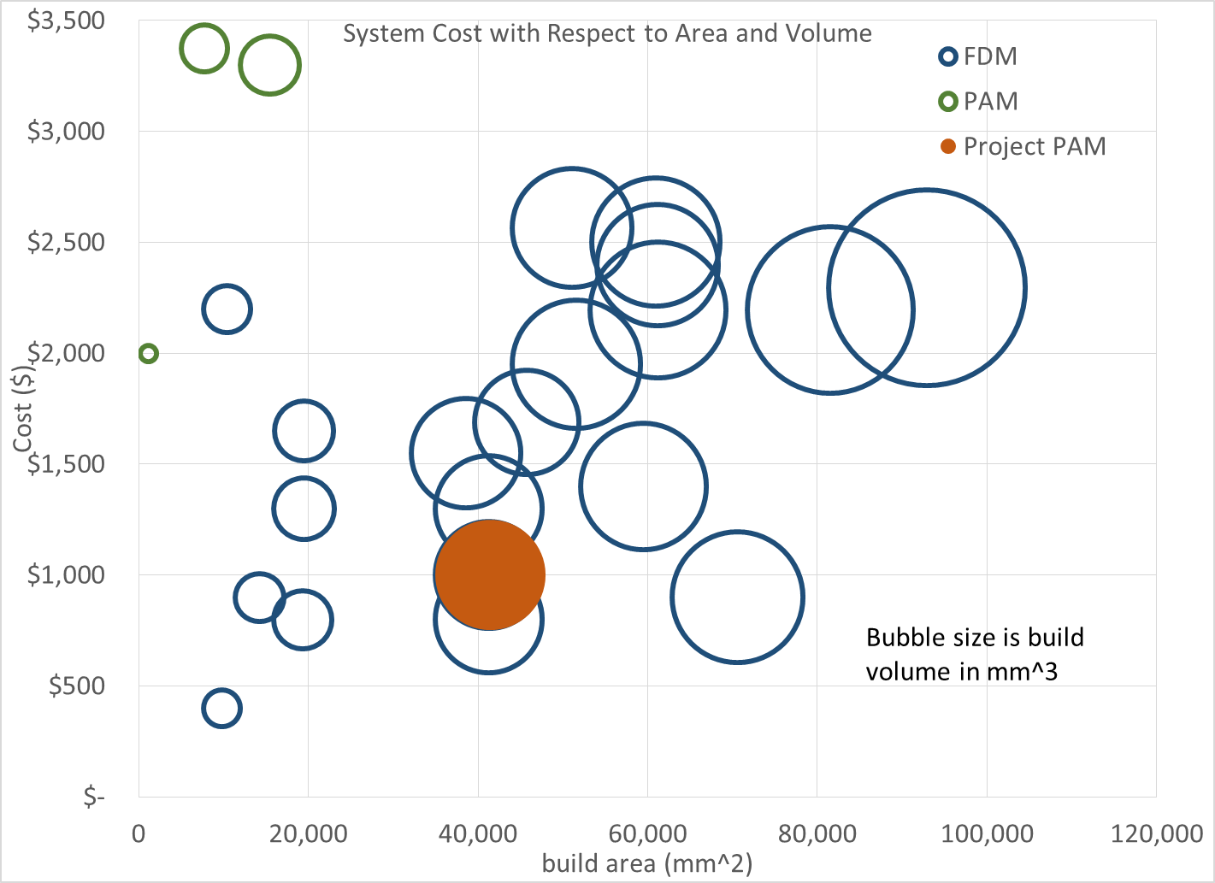
Market Gap
Figure 2. Market Gap

Slide 3
Criteria
Accessible to the hobbyist
Open Source and Free (as in speech)
Precise and repeatable
Flexible for the end user

